Slide 1




<PeopleSoft>
<Inventory>
10 June 2016

Slide 2
Inventory - Basics
Inventory is a record of goods and materials, held available in stock by a business.
It provides us a detailed list of items that are in stock at a given point of time.
Inventory Tries to Match Demand to Supply or Vice Versa

Slide 3
Inventory - Basics
How is inventory applicable to PeopleSoft ?
Inventory module in PeopleSoft is used for maintenance and managing of stock of materials owned by a company.
This includes keeping a track of usage and replenishment of these items.
It also helps in issuing of new items as and when required.

Slide 4
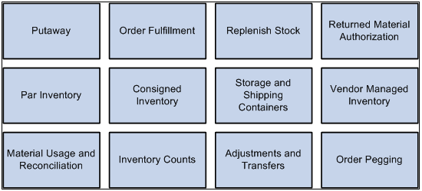
PeopleSoft Inventory Business Processes

Slide 5
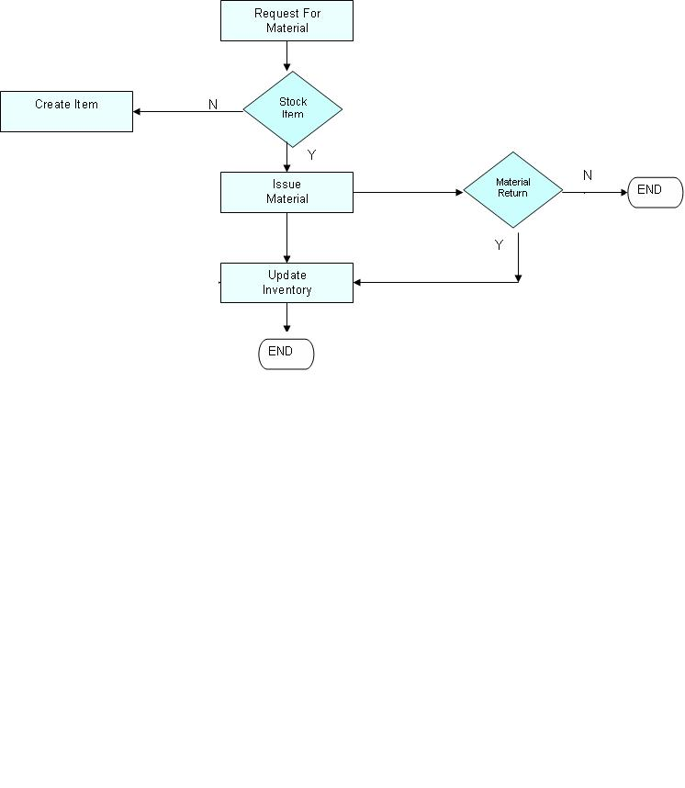
Issue Of Material

Slide 6
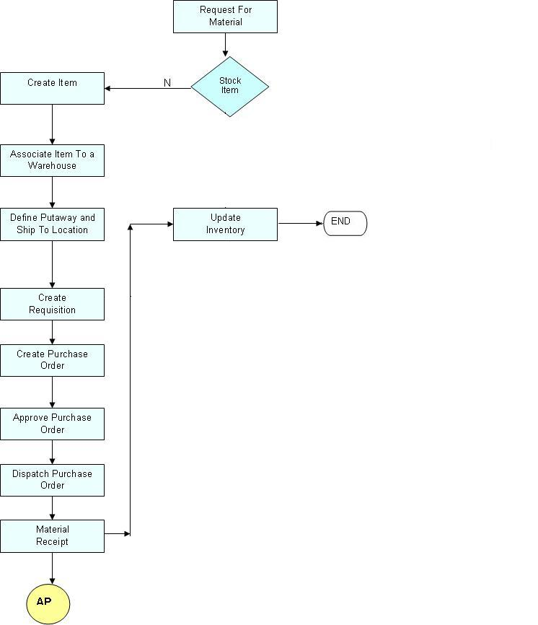
New Item Creation

Slide 7
Putaway Process for Interunit Transaction
Material Stock Request Raised
Interunit & RMA Receiving
Load Staged Items
Correct Staged Errors
Stock Room Feedback
PeopleSoft Inventory
Complete Putaway

Slide 8
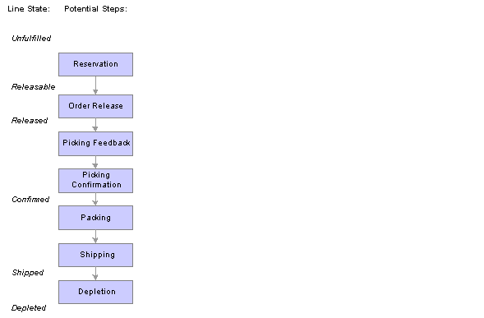
Order Fulfillment Process

Slide 9


Thank You
Our Business Knowledge,
Your Winning Edge.

